Slide 1

Spring Tool Suite IDE
Source: Codejava.net

Slide 2
1. About Spring Tool Suite IDE
Spring Tool Suite is an Eclipse-based IDE which is dedicated for developing Spring-based projects. It is actively developed and maintained by the SpringSource community. STS facilitates and simplifies Spring-based applications development by providing robust project templates such as Spring Batch, Spring Integration, Spring Persistence (Hibernate + JPA), Spring MVC, etc.
In addition, with Maven integration, STS releases developers from manually managing Spring jar files in their projects. You always get the latest update of Spring artifacts from Maven repository.
You can choose to download and install STS in one of three ways:
Download and install STS from an installer program.
Install STS through Eclipse update.
Download and extract zip archive.

Slide 3
Install Spring Tool Suite for existing Eclipse IDE
Click Help > Eclipse Marketplace… from Eclipse’s main menu. The Eclipse Marketplace dialog appears, type Spring Tool Suite or STS into the Find textfield and hit Enter. Eclipse will send query to its server and display results as shown below

Slide 4
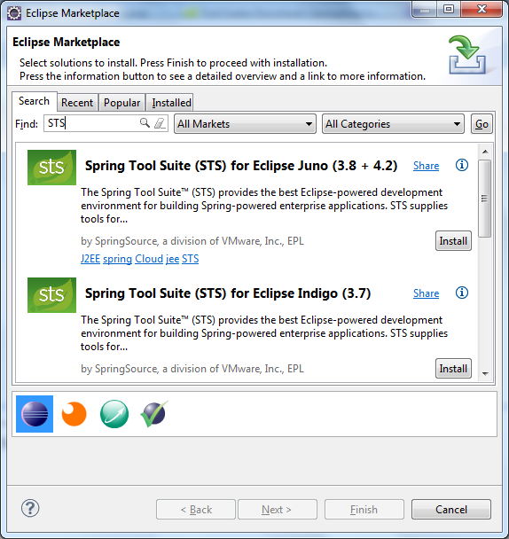

Slide 5
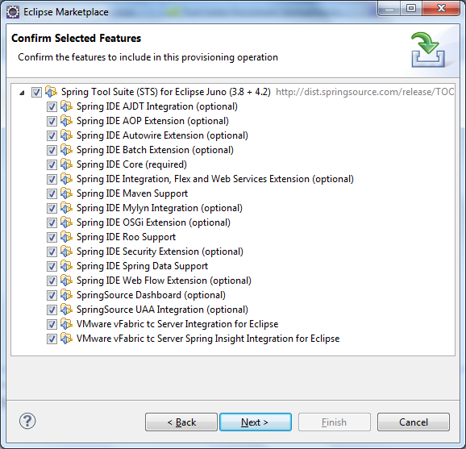
Select the version that matches your Eclipse’s version and click Install button. Here we select Spring Tool Suite (STS) for Eclipse Juno (3.8 + 4.2). It takes a while for Eclipse to fetch the details and show the features of STS as shown below:

Slide 6
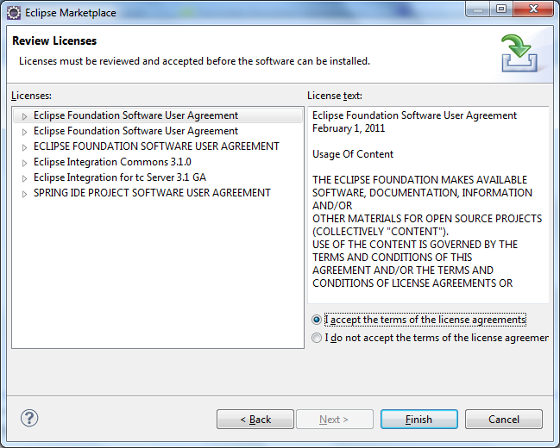
All features are selected by default, click Next. The Review Licensesscreen appears:

Slide 7
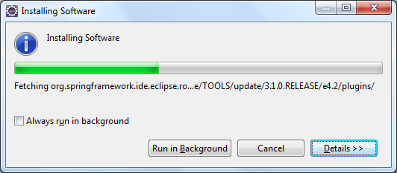
Select I accept the terms of the license agreements, and then click Finish. Eclipse will install STS and display the progress:

Slide 8
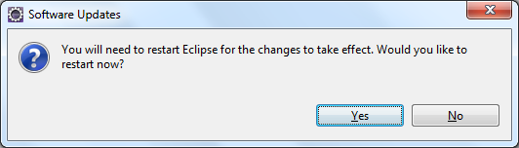
After the installation completed, Eclipse asks to restart the IDE:

Slide 9
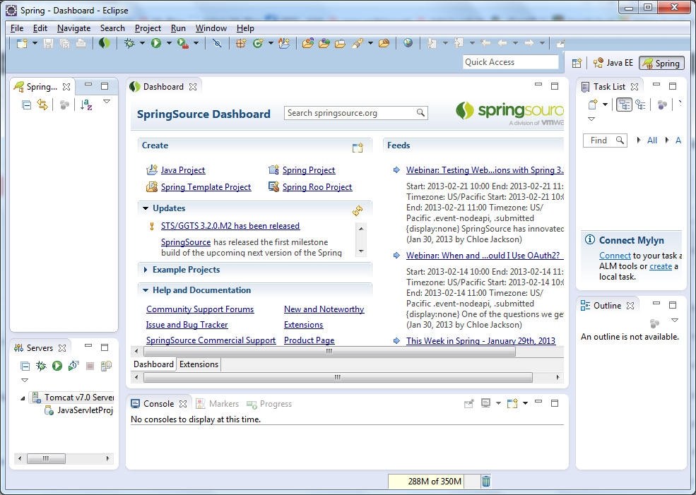
Click Yes to restart the IDE. When Eclipse restarted, you will see some Spring natures are added to the IDE. The first thing is Spring perspective:

Slide 10
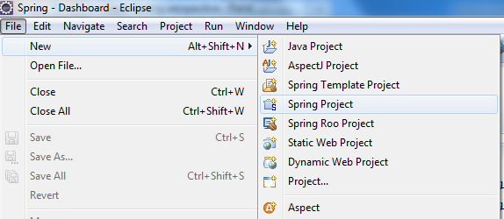
The menu File > New now comes with some Spring projects:

Slide 11
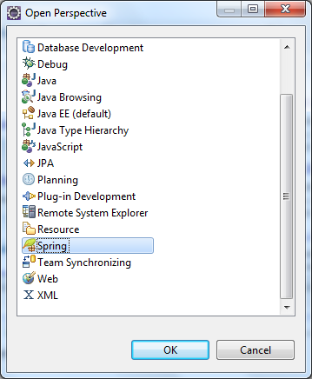

Slide 12
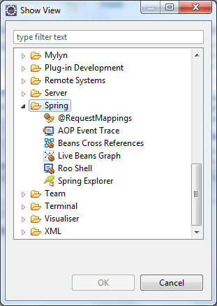
We can also show Spring views from the menu Window > Show View:

Slide 13
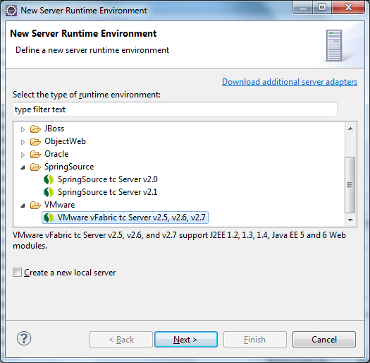
And new options in the New Server Runtime Environment dialog:

Slide 14
Now you are ready to develop your Spring-based projects in your favorite Eclipse IDE.

